Slide 1

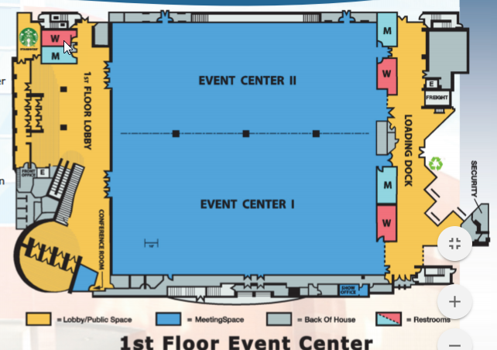
Tables for eating (not part of pattern)
Pre-stage
STAGE
Northern Kentucky Convention Center
Street Level
Competitions in Event Center I
Pre-stage in Event Center II
Pattern shown as green arrows Kentucky

Slide 2
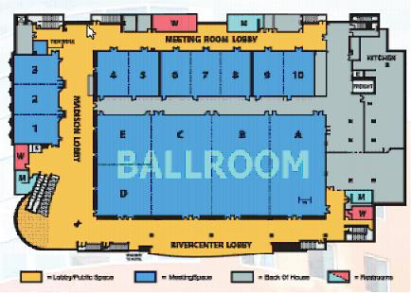
Warm-up 4-5
Quartet photo
Freight Elevator
Warm-up
1-2
Small elevator
Northern Kentucky Convention Center
Second Floor
Warm-up Rooms
Quartet Photo Room
Small Elevator
Freight Elevator for limited use
Pattern from Marriott Skywalk and top of stairs in blue
Pattern to exit to pre-stage in green

